Slide 1





THE ELDORET
INTERNATIONAL BUSINESS SUMMIT 2026
4th EDITION
Date
23RD TO 25TH APRIL 2026
Venue
Rupa Mall Grounds
THEME
Eldoret City, The Gateway to Africa’s Trade, Innovation and
Economic Future

Slide 2
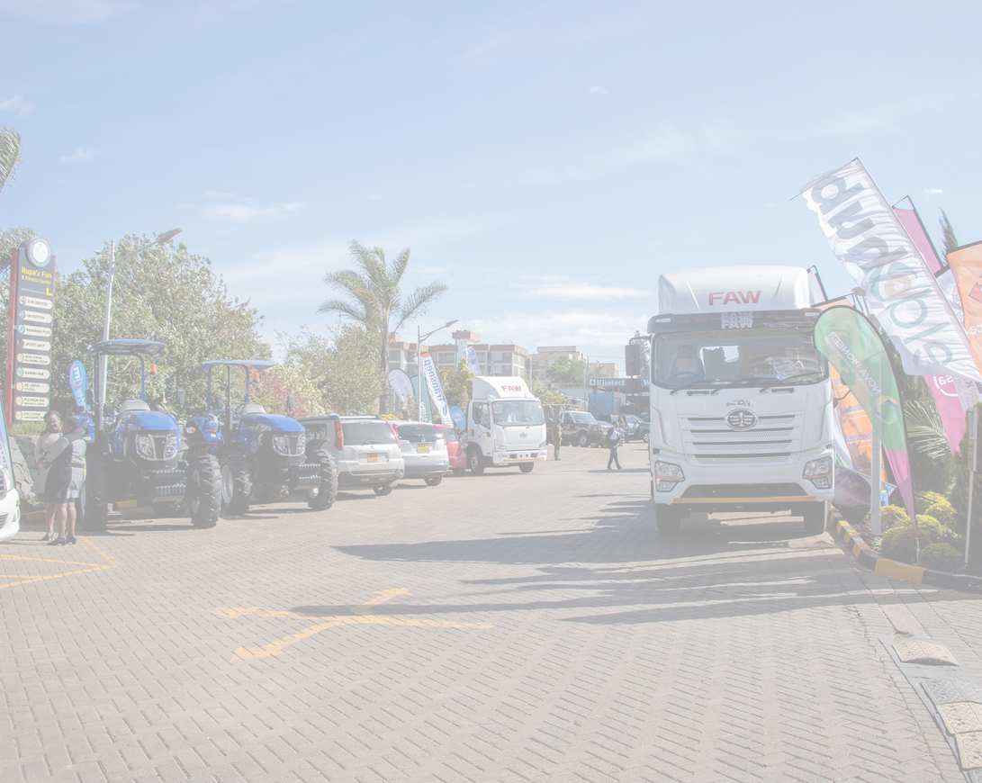
Preamble The Eldoret International Business Summit 2026 positions Eldoret City as a strategic convergence point for trade, investment, innovation, and industrial growth, linking East Africa to broader African and global markets. This Summit arrives at a pivotal time to highlight Eldoret’s role in Africa’s evolving economic landscape. Introduction In a rapidly evolving economic landscape, businesses must adapt to emerging challenges and seize new opportunities. The Kenya National Chamber of Commerce and Industry (KNCCI) in collaboration with Uasin Gishu County Government and other stakeholders is organizing the Eldoret International Business Summit 4th Edition 2026 under the theme Eldoret City, The Gateway to Africa’s Trade, Innovation and Economic Future. The Summit aims to bring together key stakeholders from diverse sectors to explore investment opportunities for sustainable business growth. It will provide a plat-form for knowledge exchange, Innovation, networking and partnerships, fostering economic development across the region and beyond.
Eldoret, known as the City of Champions, is a thriving business hub in the North Rift region and a key gateway to East and Central Africa. Renowned for its world-class athletes and vibrant economy, the city plays a vital role in regional trade, agribusiness, manufacturing, and logistics. Its strategic location along major trade corridors, well-developed infrastructure, and growing industrial base makes it an ideal destination for investment and business expansion.
The third edition of the summit was a resounding success, attracting over 10,000 participants and featuring over 200 exhibitors showcasing diverse innovations, products, and services. The event was graced by investors from the North Rift Economic Bloc (NOREB), policymakers, International Delegates, Exhibitors, National Government and County Governments, Ambassadors, Trade Consulars and participation of businesses across East Africa. Some of the notable impacts the event achieved are:- over 30 MOUs signed, Business visibility, Policy Recommendations, Investment Prospects, Over 500 women and youths trained and mentored, TVETs – Connecting theory to practice, Job opportunities and skill development among other achievements.
Building on this success this year's summit will be bigger. We expect to have over 15000 delegates, 250 exhibitors, High level national and international delegation, National and County Government, Chamber President and Chamber Leadership, Host Governor and NOREB Governors, Government Agencies, Captains of Industries among other dignitaries.

Slide 3






Objectives
Showcase Investment Opportunities:
Highlight lucrative investment opportunities in North Rift, focusing on key sectors such as manufacturing, real estate, agriculture, and technology, Sports Tourism, Hospitality, Logistics, Healthcare, Waste Management, Education, Import and Export.
Facilitate Networking:
Offer a conducive environment for entrepreneurs, business leaders, and stake- holders to connect, collaborate, and facilitate B2G, B2B, B2C networking across various industries and MOU signing.
Support Policy Dialogue:
Encourage discussions with policymakers to create an enabling environment for business growth and innovation.
Enhance Mentorship and Knowledge Sharing:
Present a platform for exchanging best practices, success stories, and insights on sustainable business strategies.
Youth and women in business mentorship
Promote Innovation:
Inspire businesses to embrace innovative approaches such as AI that address current market challenges and capitalize on emerging opportunities.
Drive Sustainable Practices:
Emphasize the importance of integrating sustainability into business operations for long-term success.
www.uasingishuchamber.co.ke

Slide 4
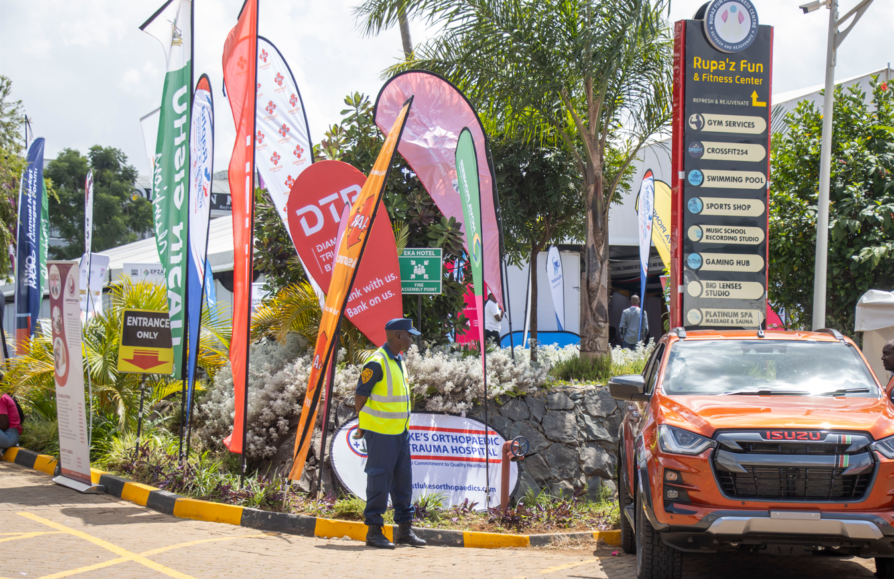
Key Features
Business Exhibitions:
A show case of innovative products, services, and solutions from participating companies.
Keynote Speeches:
Insights from industry leaders, Policy Markers, Innovators and experts on emerging trends and sustainable business growth strategies.
Panel Discussions:
Interactive sessions addressing topics such as Investment opportunities, Agribusiness, Sports, Tourism, Healthcare, innovation and technology, among others.
Networking Sessions:
Opportunities to forge meaningful relationships and explore potential collaborations.
Gala Networking Dinner:
A high-level dinner to foster connections among stakeholders in a relaxed setting.
Skill Development Sessions:
Practical workshops on innovation, skill enhancement, and strategic business planning.
www.uasingishuchamber.co.ke

Slide 5









Target Audience
Business Owners, Youth and Women Businesses, Jua kali, Manufacturers and Entrepreneurs
Industry Professionals and Experts
Local and International Investors
Government Representatives, CEOs and Policymakers (National and County levels)
Academic and Research Institutions, TVETS and Universities
Media and Communication Specialists
Financial Institutions, Insurance companies, Saccos
Development Partners, NGO’s, Regulators, Farmer cooperatives
Athletes
Expected Outcomes
Enhanced Business Knowledge
Participants will gain valuable insights into innovative practices and strategies for sustainable growth.
New Business Opportunities
Facilitation of collaborations and partnerships among participants. Increase in Intra Africa Trade.
Policy Recommendations
Formulation of actionable recommendations for policymakers to foster business innovation and growth. Signing of investment deals PPP and Private players.
Increased Visibility
Ampliﬁed visibility for participating businesses and organizations.
Investment Leads
Identiﬁcation of key investment prospects and potential partnerships in Eldoret City’s rapidly growing economy.
Participants
15000+
Exhibitors
250+
Countries
10+
Delegates
1500+
www.uasingishuchamber.co.ke

Slide 6

Partnership and Sponsorship Opportunities
The Summit offers several partnership and sponsorship packages tailored to enhance brand visibility, provide speaking opportunities, youth mentorship, exhibition spaces, and grant access to exclusive networking events
Package | Platinum | Gold | Silver | Bronze | Brass
VALUE | 2,000,000 | 1,000,000 | 500,000 | 250,000 | 100,000
PRESENTATION | MINUTES | 25 MINUTES | 10 MINUTES | 5 MINUTES | X
PANELIST |  |  | X | X | X
FEATURE IN CHAMBER MAGAZINE |  |  | X | X | X
DISPLAY AND EXHIBITION SPACE | 9*3 | 6*3 | 6*3 | 3*3 | 3*3
MEDIA AND SOCIAL MEDIA COVERAGE | VERY HIGH | HIGH | MEDIUM | STANDARD | BASIC
BRADING | UNLIMITED | LIMITED | LIMITED | MINIMUM | MINIMUM
ENTRY TICKETS TO SIDE EVENTS, GALA DINNER & COCKTAIL | VIP CORPORATE TABLE FOR 10 | CORPORATE DINNER TABLE FOR 8 | 5 DINNER CARDS | 3 DINNER CARDS | 1 DINNER CARD
RECONITION BY MASTER OF CEREMONY | VERY HIGH | HIGH | MEDIUM | STANDARD | BASIC
MEMBERSHIP TO KNCCI |  |  |  | X | X
CERTIFICATE OF PARTICIPATION
www.uasingishuchamber.co.ke

Slide 7
Investment Opportunities in North Rift
Eldoret, Kenya’s 5th city, conferred city status on 15 August 2024, is located in the North Rift region of Kenya. Uasin Gishu County has a projected population of approximately 1.31 million people (2025 estimate), providing a rapidly growing consumer and production base. The wider North Rift region offers a critical mass that supports economies of scale in production and marketing across multiple sectors.
The county enjoys a favorable cool temperate climate, with average annual rainfall ranging between 900–1,200 mm, making it suitable for a wide variety of agricultural activities. The region’s proximity to East African Community (EAC) partner states and access to COMESA member markets provides significant regional and international trade opportunities.
Uasin Gishu County is strategically positioned to serve markets across East and Central Africa, including Tanzania, Uganda, Rwanda, the Democratic Republic of Congo, South Sudan, and Burundi, creating strong demand for fresh produce, value-added goods, and manufactured products. Eldoret functions as a major logistics and distribution hub, supported by an international airport, as well as extensive rail and road networks linking Western Kenya and Uganda, facilitating efficient access to raw materials and export markets.
In addition, neighbouring counties Trans Nzoia, Nandi, Elgeyo Marakwet, Baringo, West Pokot, and Turkana present complementary opportunities in commercial agriculture (including tea, maize, wheat, and dairy), agro-processing, tourism circuits, sports and cultural tourism, and collaborative regional investment platforms that can expand value-added production and cross-county trade.
Agriculture & Agribusiness
The North Rift is Kenya’s breadbasket, with opportunities in large-scale maize, wheat, dairy, tea, coffee, horticulture and livestock production across Trans Nzoia, Uasin Gishu, Nandi and Elgeyo Marakwet; irrigated agriculture in Baringo, West Pokot and Turkana; and value addition, cold chains, agro-processing, packaging and export-oriented agribusiness hubs serving regional and international markets.
Manufacturing & Industrialization
Regional agro-processing zones, fertilizer and animal feed production, textile and leather processing, steel and metal fabrication, plastics, cosmetics, and vehicle and motorcycle assembly, leveraging raw materials from neighboring counties and industrial parks anchored in Eldoret and satellite towns.
Energy & Green Solutions
Large-scale solar and wind energy projects in Turkana, Baringo and West Pokot; geothermal and hybrid mini-grids; biogas and biofuel production leveraging agricultural and municipal waste across the region.
www.uasingishuchamber.co.ke

Slide 8
Healthcare & Medical Industry
Private and specialized hospitals, regional diagnostic and referral centers, pharmaceutical and medical equipment manufacturing, and healthcare supply chains serving the wider North Rift population
Sports & Recreation
Sports academies and talent development centers Stadia, golf courses and recreational facilities Fitness, wellness and sports performance centers
Tourism & Hospitality
Eco-tourism, lodges, and resorts
Conference centers and business hotels
Adventure tourism (cycling, and cultural tourism)
Water & Irrigation
Large-scale irrigation systems
Borehole drilling and water supply services
Water bottling and puriﬁcation plants
Waste Management & Recycling
Regional solid waste management systems, plastic and e-waste recycling plants, organic waste-to-energy and compost production supporting sustainable urban and agricultural growth.

Slide 9
Technology & Innovation
ICT hubs, AgriTech and climate-smart solutions, fintech for agribusiness and MSMEs, automation, AI, electronics assembly, and digital trade platforms connecting producers across counties to regional and global markets.
Real Estate & Infrastructure
Affordable housing, mixed-use developments, industrial parks, logistics hubs and dry ports, warehousing and cold storage facilities supporting intra-Africa trade across Kenya, Uganda, South Sudan, DR Congo and Rwanda.
Mining & Natural Resources
Exploration and value addition in construction materials, minerals and natural resources in Baringo, West Pokot and Turkana, including cement, gypsum and stone processing.
Fisheries & Aquaculture
Commercial fish farming and processing (Lake Turkana and inland waters) Fish feed production and aquaculture value chains Cold storage and fish export logistics
Education & Research
Private universities, TVETs, centers of excellence in agriculture, engineering, sports science and renewable energy, research and development partnerships, and digital learning platforms supplying skilled labor to the regional economy.
Conclusion
The Eldoret International Business Summit 2026 is poised to be a transformative event that inspires, connects, and empowers businesses. Through meaningful dialogue and collaboration, it will drive sustainable business growth and contribute signiﬁcantly to economic development. We invite all stakeholders to participate, share, and contribute to the success of this pivotal event.

Slide 10

For inquiries, partnerships, and sponsorships, please contact Email: events@uasingishuchamber.co.ke Phone: +254 740 853 372 Office Location: Daima Towers, M2 Room 9, Eldoret.

